Slide 1

Employee Data Analysis Using Excel
STUDENT NAME: A. Beula Grace
REGISTER NO: 2213371036008
NM I'd: EF305B003952D8BA7BC4233BA33D8ED1
DEPARTMENT: Commerce
COLLEGE: Quaid -E- Millath Government College for Women

Slide 2

PROJECT TITLE
Employee Performance Analysis Using Excel

Slide 3

AGENDA:
1. Problem Statement
2. Project Overview
3. End Users
4. Our Solution and Proposition
5. Dataset Description
6. Modelling Approach
7. Results and Discussion
8. Conclusion

Slide 4

PROBLEM STATEMENT:
Employees performance score is analysed for:
Identifying Strengths and Weaknesses
Enhancing Productivity
Employee Development
Motivating Employees
Identifying Potential Leaders

Slide 5

PROJECT OVERVIEW :
In this project, the employees performance score is analysed with the help of data collected from the employees. These data's are analysed using MS - Excel technique.

Slide 6

WHO ARE THE END USERS:
The ended users of this project is useful for:
Human Resources (HR) Department
Managers and Team Leaders
Executives and Senior Management
Compensation and Benefits Teams
Recruiters

Slide 7

OUR SOLUTION AND ITS VALUE PROPOSITION
To analyze employee performance scores effectively to track trends over time, compare against benchmarks or goals, and consider external factors that may influence performance. Regular reviews and feedback loops are crucial for ongoing improvement.

Slide 8

DATASET DESCRIPTION:
Contains data on employee performance scores, including metrics for individual productivity, efficiency, and overall contribution, used for assessing and improving workforce performance.

Slide 9

THE "WOW" IN OUR SOLUTION:
Our solution highlights key aspects of performance analysis like tracking trends, benchmarking, and considering external factors. Regular reviews and feedback loops are also essential for continuous improvement.

Slide 10

MODELLING:
Data collection:
Raw data from Kaggle
Analysing it through Excel
Feature collection:
Looking it thorugh Pivot table &
overview the results by applying
formulae
Formulae enhances to get the
result for their individual act
Data cleaning:
Sort out the unnecessary data
by filtering option.
Taking out considered data by
Pivot able.

Slide 11
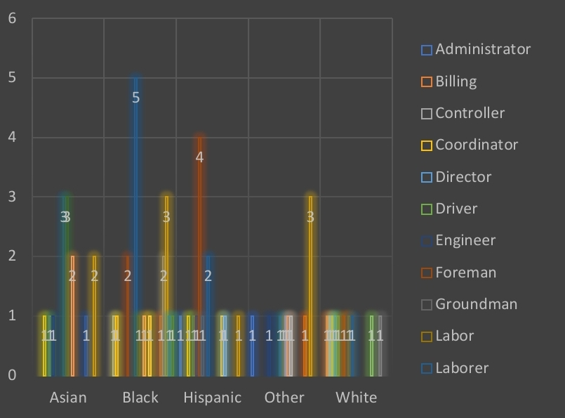

RESULT:

Slide 12

CONCLUSION:
In conclusion, the employee performance score data highlights individual and team strengths and areas for improvement. Analyzing these scores provides valuable insights into overall productivity and effectiveness, guiding future strategies for professional development and organizational growth.

Slide 13


